Slide 1


Accident Data Analysis
Traffic accidents pose a significant public safety challenge, affecting lives, infrastructure, and economies worldwide. This analysis explores accident data to uncover patterns, identify risk factors, and provide actionable insights to improve road safety.

Slide 2

Dataset Overview
Source
Key Fields
Accident data from 2019 (1,048,575 records)
Date, Severity, Location (Latitude & Longitude), Light & Weather Conditions, Number of Vehicles, Number of Casualties
Objective
Identify trends and contributing factors to enhance safety measures and inform policy decisions.

Slide 3
Accident Trends Over Time
Observation
Possible Causes
The number of accidents varies throughout the year, with peaks during specific months.
Increased traffic volume during holidays, adverse weather conditions, and road maintenance schedules.

Slide 4
Severity Distribution
Observation
Key Factors
The majority of accidents are categorized as slight, but a significant portion are serious or fatal, particularly under specific conditions.
Road type, lighting conditions, and vehicle involvement contribute to accident severity.

Slide 5

Vehicle Involvement
1
Multi-Vehicle Accidents
Associated with higher casualty rates.
2
Fatal Accidents
More frequent when heavy vehicles (e.g., trucks, buses) are involved.

Slide 6
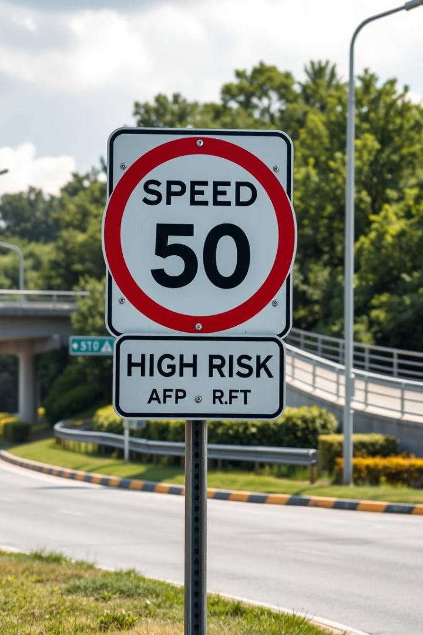


Policy Changes for High-Risk Areas
Speed Limits
Enforce stricter speed limits in accident hotspots.
Road Infrastructure
Improve road infrastructure, signage, and lighting in high-incident locations.

Slide 7



Road Safety Enhancements Based on Environmental Factors
Drainage Systems
Smart Lighting
Upgrade drainage systems to mitigate accidents caused by heavy rainfall.
Implement smart street lighting and reflective road markers to improve nighttime visibility.

Slide 8
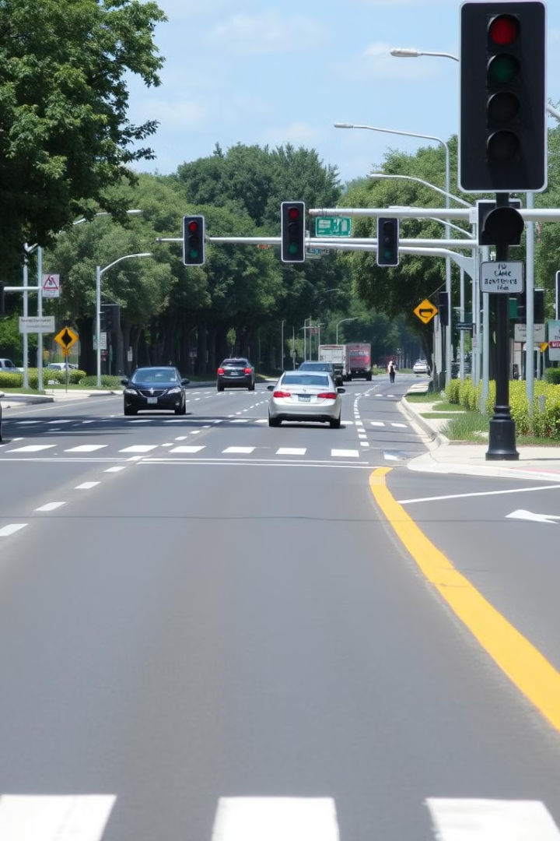
Regulations to Reduce Multi-Vehicle Accidents
1
Lane Discipline
Strengthen lane discipline and enforce traffic regulations for heavy vehicles.
2
Awareness Campaigns
Conduct awareness campaigns to promote safe driving behaviors.
3
Traffic Signals
Introduce adaptive traffic signals and dedicated lanes for heavy vehicles to reduce congestion-related accidents.

Slide 9

Key Takeaways
1
Data-Driven Insights
2
Targeted Interventions
Accident data analysis provides critical insights into the factors contributing to road accidents.
Implementing targeted interventions based on these findings can significantly reduce accident rates.
3
Enhanced Road Safety
Data-driven safety improvements are essential for enhancing road safety and saving lives.

Slide 10
Conclusion
This analysis provides critical insights into the factors contributing to road accidents, emphasizing the importance of data-driven safety improvements. Implementing targeted interventions based on these findings can significantly reduce accident rates and enhance road safety.

